Slide 1
THE HISTORY

Slide 2
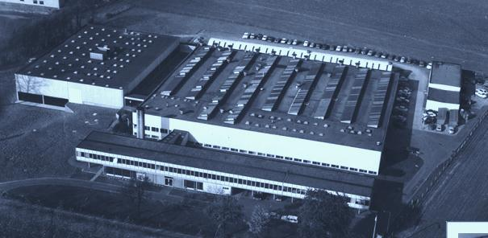
ADB – Your Partner for Light
1920 ADB originally founded in by Mr Adrien de Backer – whose initials provided the company name - began its life as a manufacturer of electrical equipment for laboratories, mainly rheostats.
1925 ADB applied the rheostats and later on the RHEOTOR® variable transformers to the dimming of light in theatres, music halls and cinemas. The company was, notably, responsible for producing the first light dimmer for the Malines City theatre in Belgium. This equipment served for over forty years.
1938 The first spotlights were introduced and soon afterward lighting control became electromechanical and partially motorized with relay control.
1950 The start of a long period, of innovations, with for ex. dimmers based on Thyratrons, on magnetic amplifiers and, since 1965, on Thyristors. And also, the first memory control desks based on punched cards, ferrites, magnetic tape, floppy disc, and finally in 1985 on microprocessors.
1987 ADB was acquired by the SIEMENS Group. At that time ADB was already strongly established as a worldwide broad line manufacturer of professional stage and studio lighting equipment.
2002 Following a management buy-out, the ADB Group was restructured, the production streamlined and upgraded in order to make of ADB a lean and agile operation able to face new challenges.
Launch of WARP, a revolutionary zoom profile spotlight with ring control and motorization of all functions
Launch of EURODIM TwinTech with free combination of Thyristor and Sinewave dimming
and the future proof DimSwitch technology with Solid State relay instead of mechanical.
2013 First all LED RGB cyclorama and floodlight unit ALC4
Today

Slide 3
1920
ADB originally founded in by Mr Adrien de Backer – whose initials provided the company name - began its life as a manufacturer of electrical equipment for laboratories, mainly resistors.

Slide 4
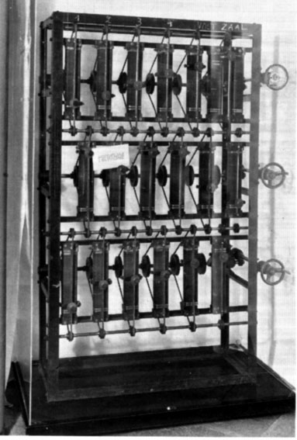
1925
ADB applied the rheostats and later on the RHEOTOR® variable transformers to the dimming of light in theatres, music halls and cinemas. The company was, notably, responsible for producing the first light dimmer for the Malines City theatre in Belgium. This equipment served for over forty years.

Slide 5
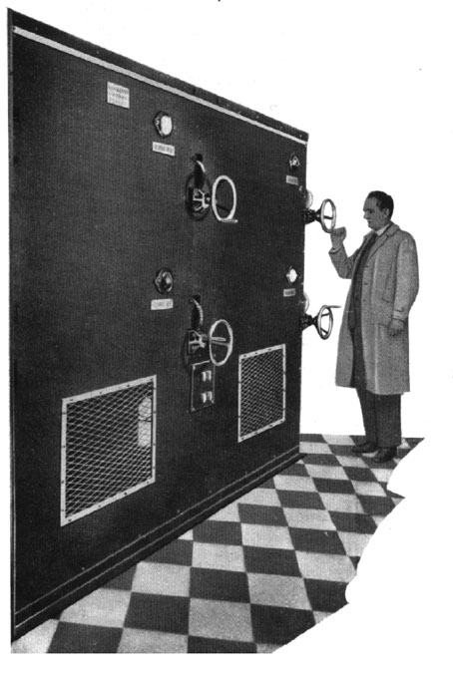
1925
ADB applied the rheostats and later on the RHEOTOR® variable transformers to the dimming of light in theatres, music halls and cinemas.

Slide 6
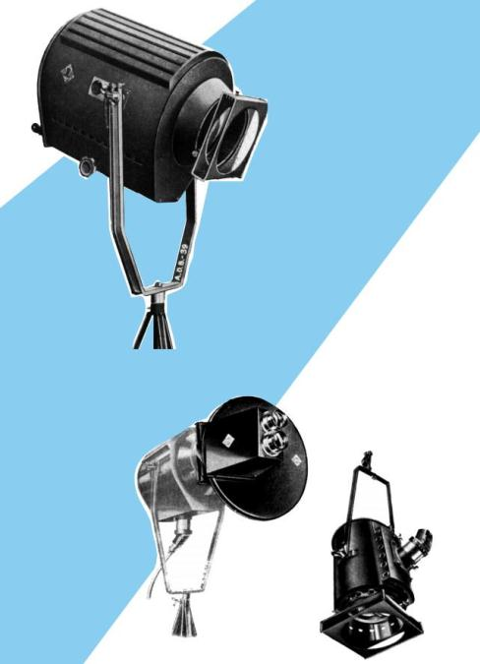
1938

Slide 7
1938
The first spotlights were introduced and soon afterward lighting control became electromechanical and partially motorized with relay control.

Slide 8
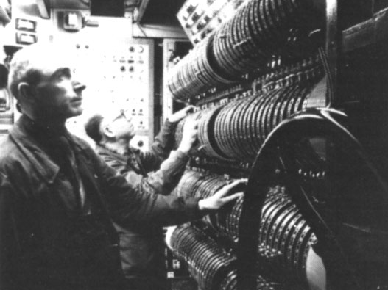
1950 - 1960
The start of a long period, of innovations, with for ex. dimmers based on Thyratrons, on magnetic amplifiers and, since 1965, on Thyristors. Also, the first memory control desks based on punched cards, ferrites, magnetic tape, floppy disc, and finally in 1985 on microprocessors.

Slide 9
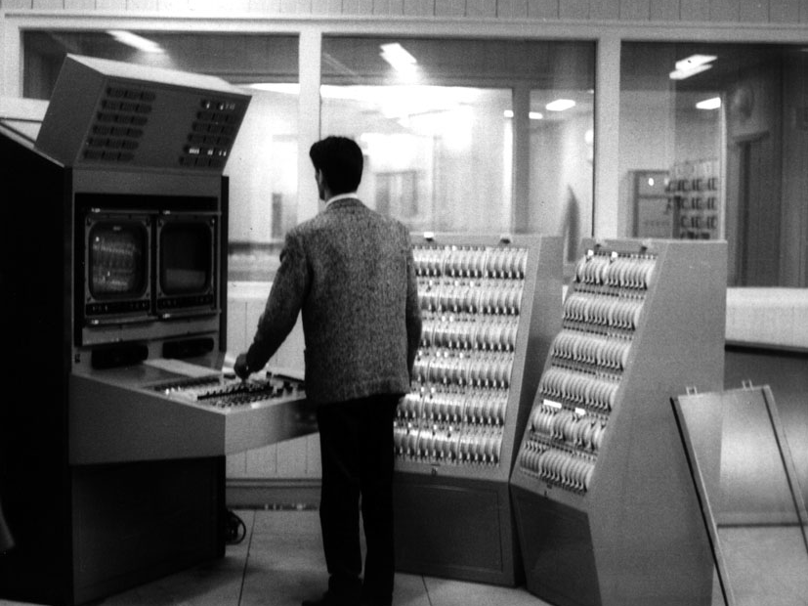
1950 - 1960
D3 TMS desk

Slide 10
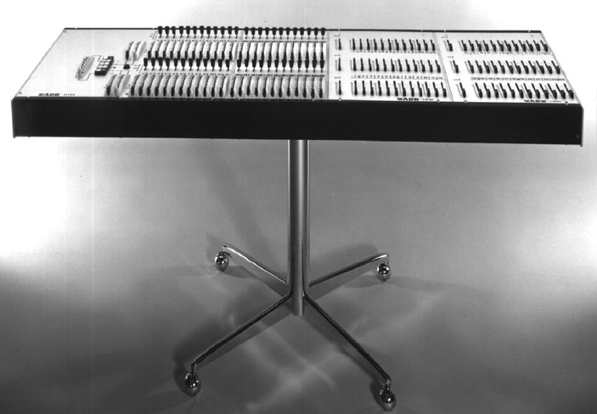
1950 - 1960
Q6 M desk

Slide 11
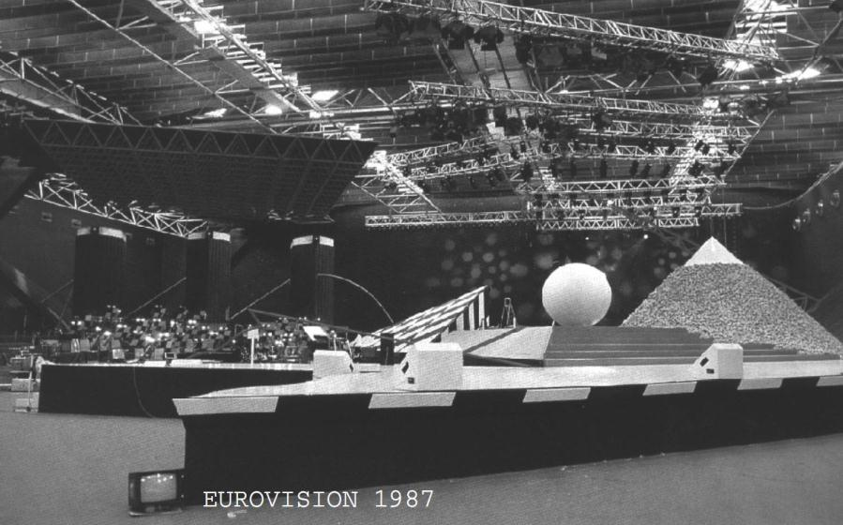
1987
ADB was acquired by the SIEMENS Group. At that time ADB was already strongly established as a worldwide broad line manufacturer of professional stage and studio lighting equipment.
ADB was official technical sponsor of RTB-F for Eurovision.

Slide 12
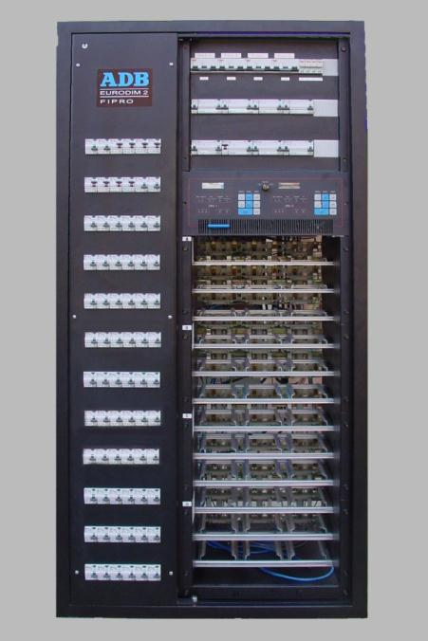
1987
ADB released the world’s 1st generation of “DIGITAL” Dimmer Series : EURODIM

Slide 13
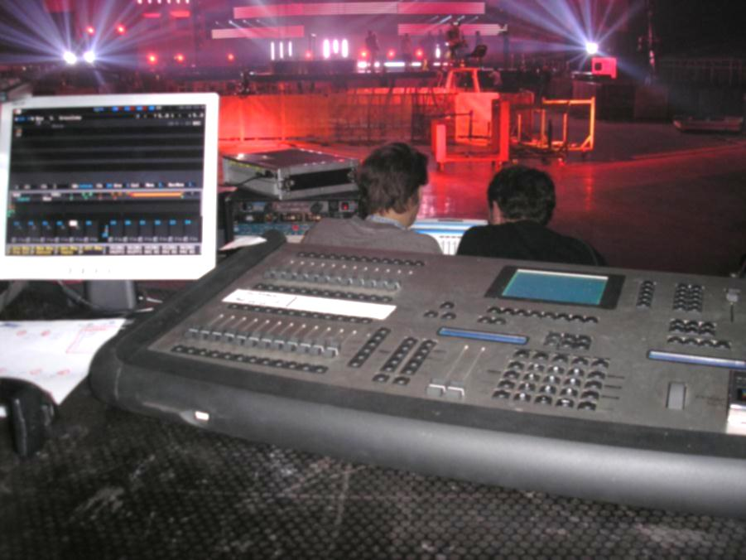
2002
Following a management buy-out, the ADB Group was restructured, the production streamlined and upgraded in order to make of ADB a lean and agile operation able to face new challenges.

Slide 14
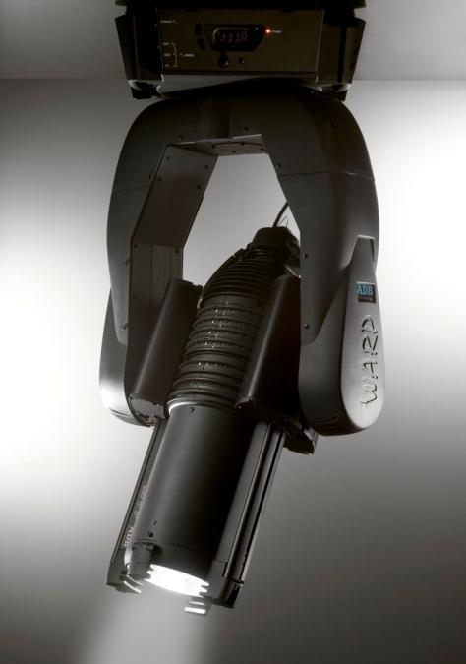
2004
Launch of WARP, a revolutionary completely fanles, silent zoom profile spotlight with ring control and motorization of all functions.

Slide 15
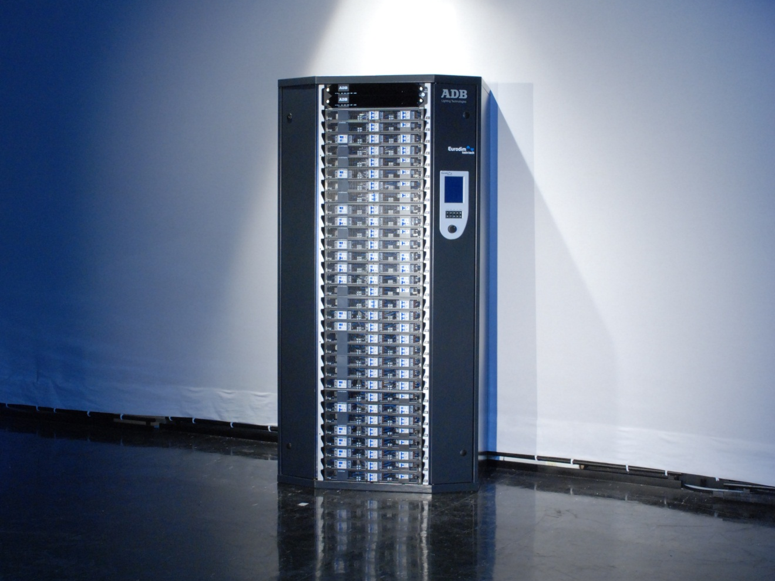
EURODIM Twin Tech
A NEW true “power management system” where every individual circuit can be a “dimmer” (with NO minimum load) or a “solid state relay”
switching “any load” at “zero crossing” without de-rating of the circuit capacity.

Slide 16
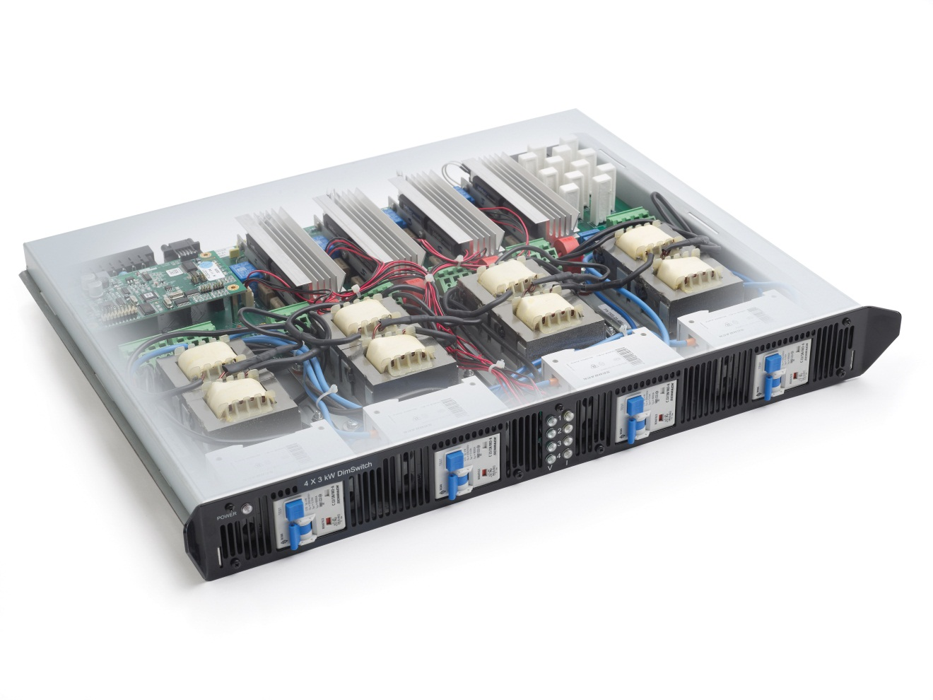
DimSwitch
DimSwitch modules in 4 x 3kW or 3 x 5kW with MCB1P+N protection and RCD per module or per circuit as an option.
Filtering 200µsec or 400µsec.

Slide 17
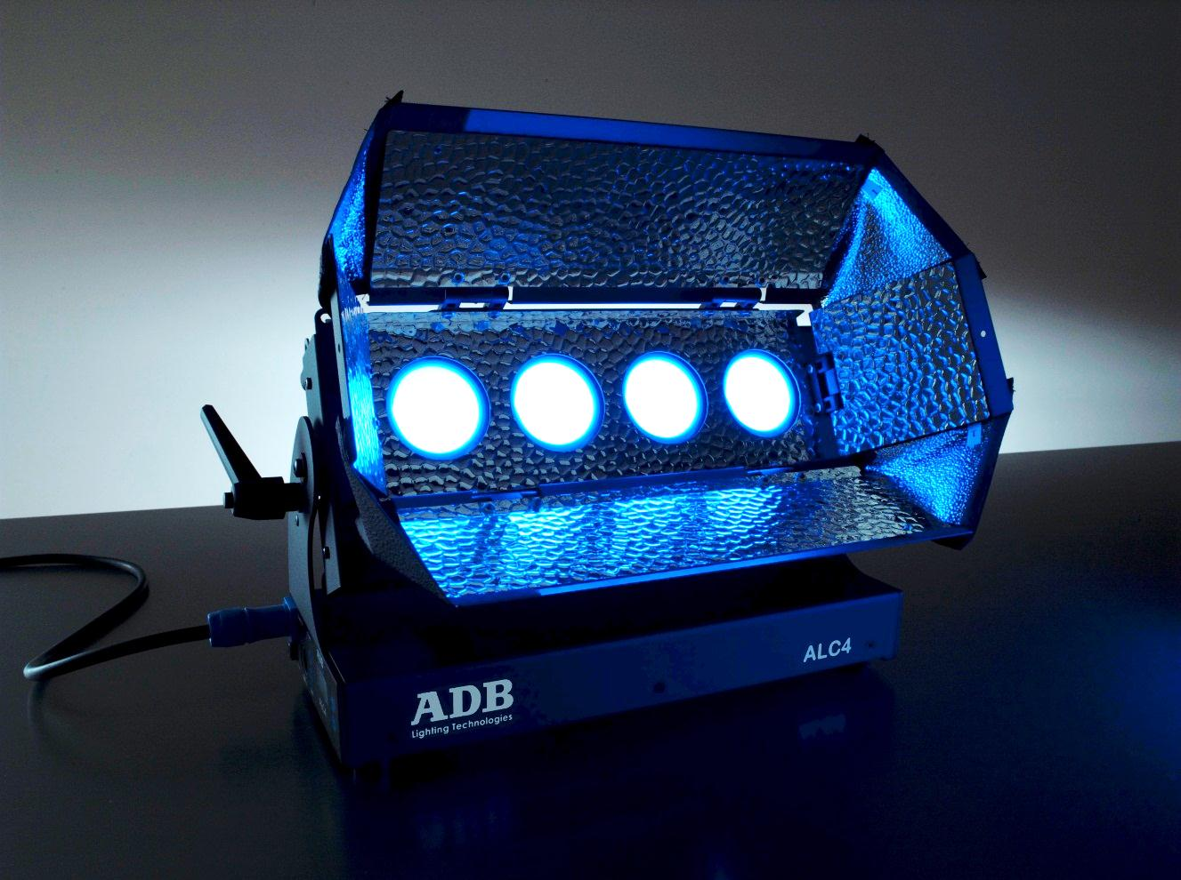
ALC4
The first and only LED instrument for Cyclorama- or Wash lighting with optical feedback of the light output and colour consistency.

Slide 18
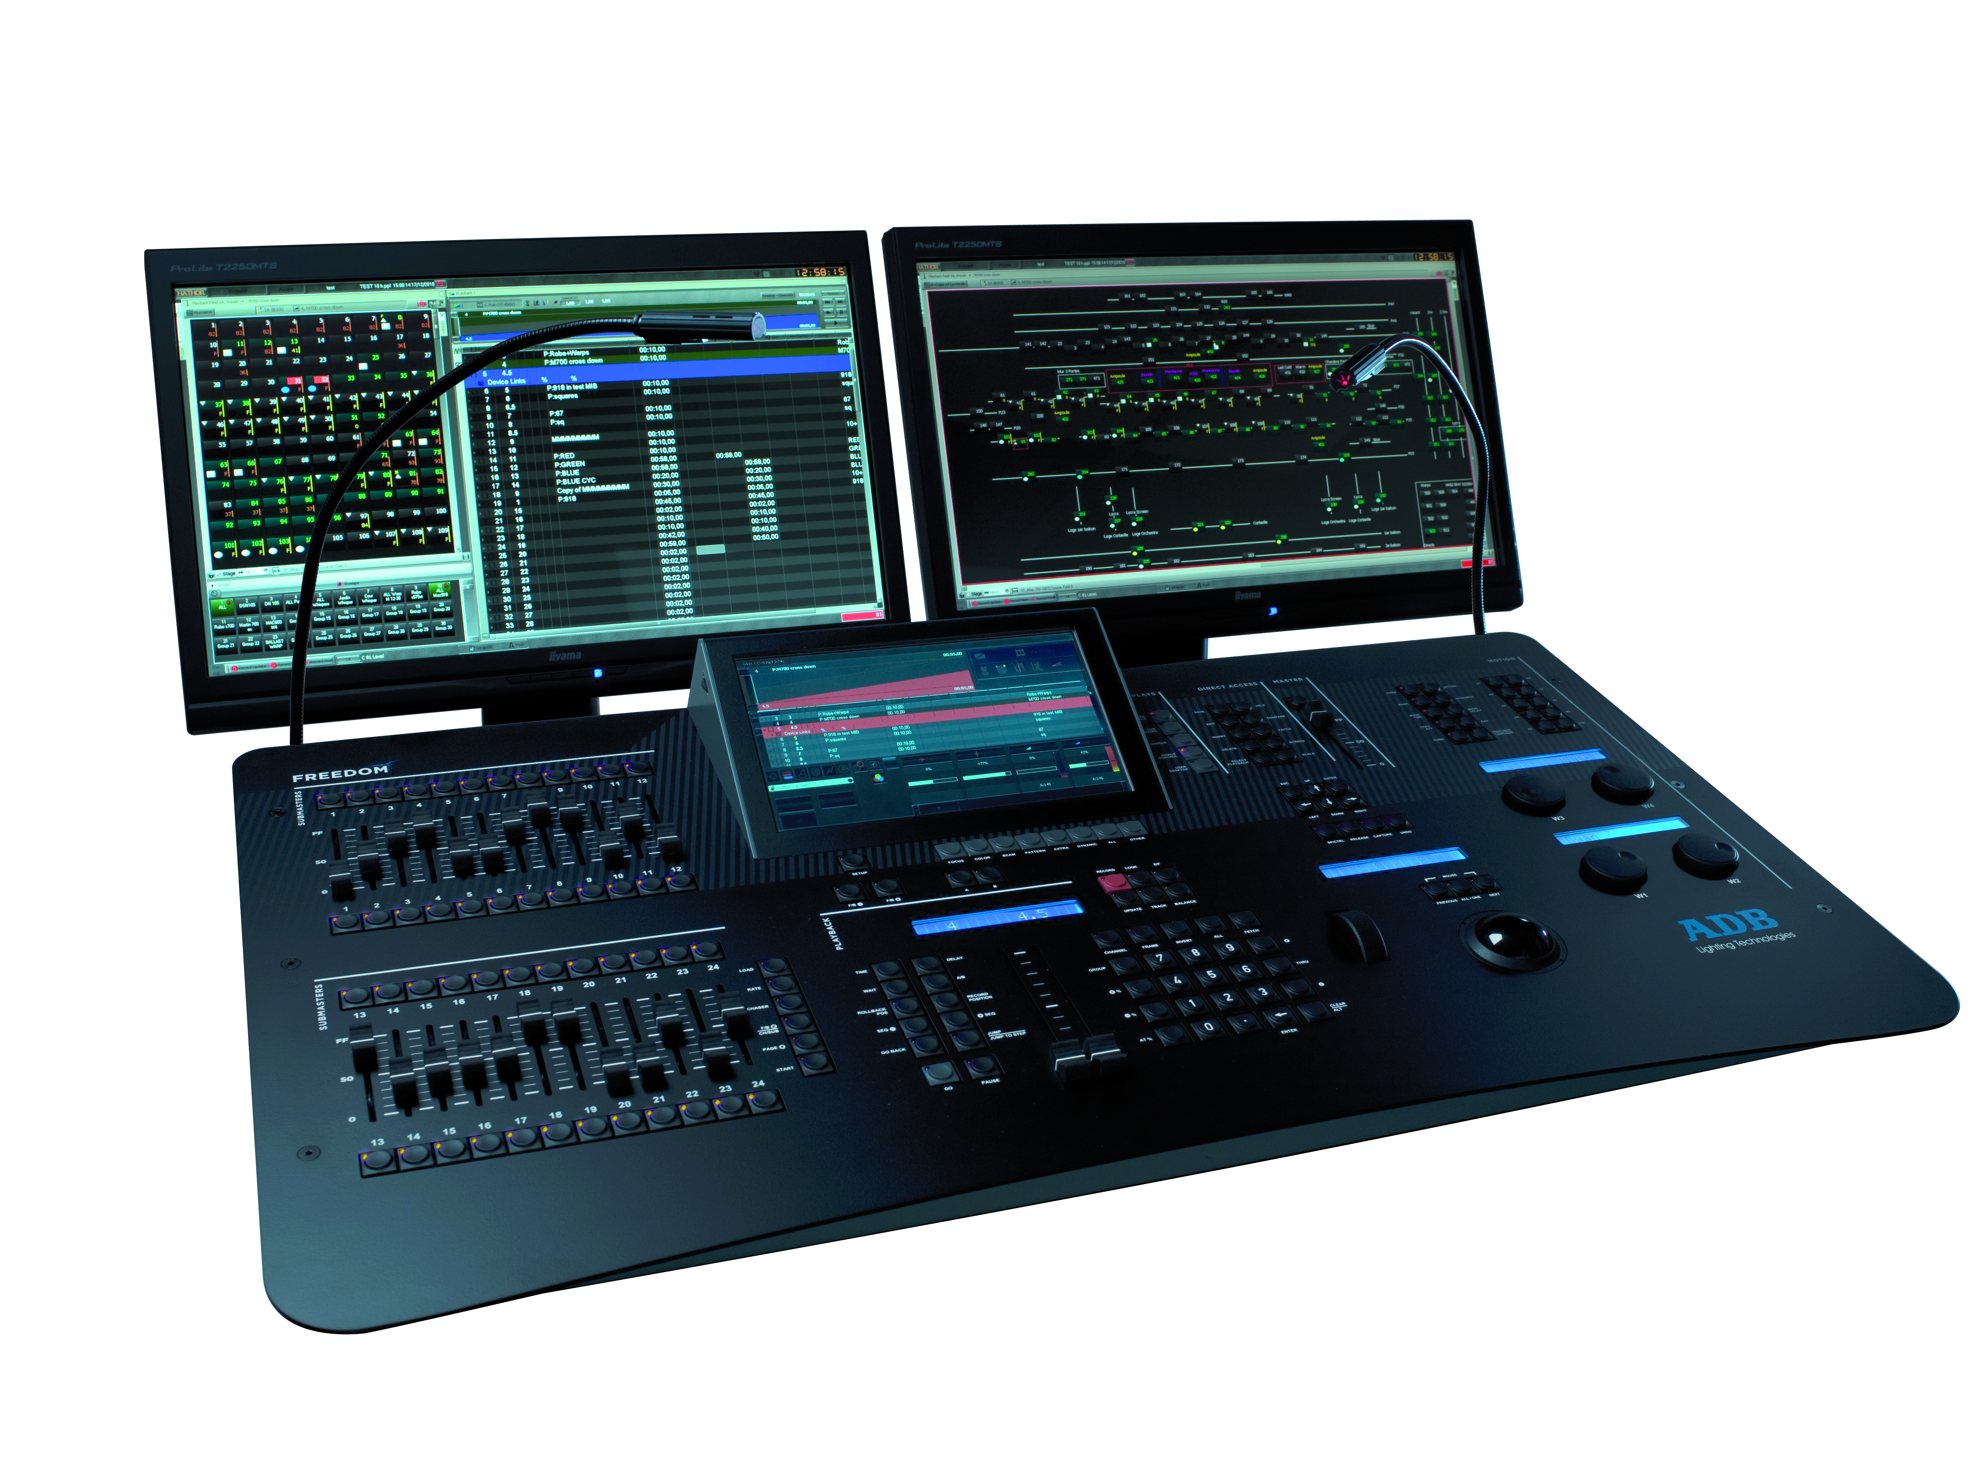
LIBERTY & FREEDOM
Based on a very performant Theatre / Opera / TV oriented software: HATHOR, this range of desks conforms to a broad range of entertainment venues, is fully integrated with CAPTURE and allows for extended networking (ArtNet, sACN, RDMNet)

